Slide 1
ENSE 374, Milestone 2
22/10/2019
Daniel Takyi
Jiwoun Kim
Mason Lane

Slide 2
Team: They Will
Were creating a web-app that provides random venues for a user to explore.
People should be able to garner a random list of curated results after entering various search parameters.
Sometimes decisions are hard - sometimes we worry. What if we miss out on something? Everyone lives with regrets. Many people find themselves wondering what curiosities they’ve overlooked or missed. This application will grant users the opportunity to discover and enjoy new experiences by suggesting random food locations. It will help the indecisive make quick novel decisions, or simply grant the experimental types new adventures to behold.
https://github.com/jiwoone/ENSE-374-Project.git

Slide 3
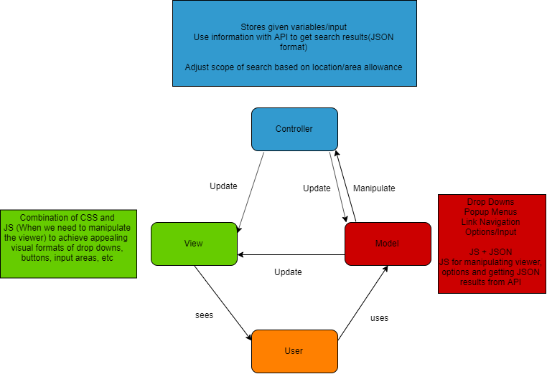
MVC

Slide 4
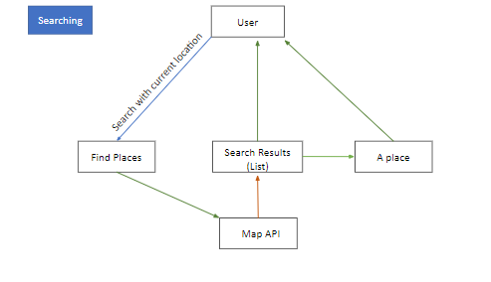
Data Flow

Slide 5
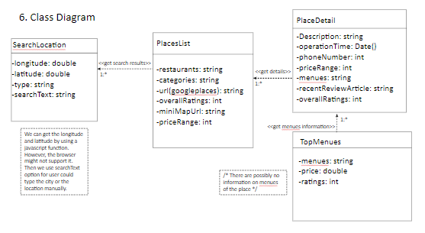
Class Diagram

Slide 6
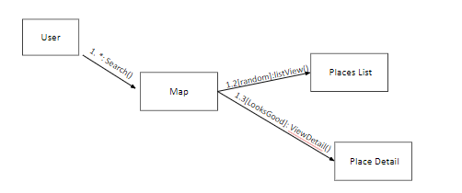
Communication/Collaboration

Slide 7
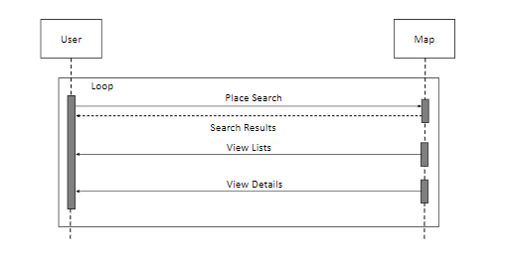
Sequence Diagram

Slide 8
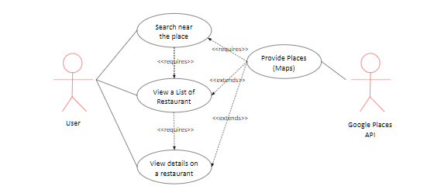
Use Case

Slide 9
LoFI

Slide 10
Requirements (We made one!)
As a MVP, we would start with pre-queried results for the regina area, and quickly expand to allow custom areas and ranges. Users should be able to select their desired distance.
Further, we could enable search functions to allow user’s a broader range of uses - not limited to food locations
It has to be handy - something someone can use moments before getting to their garage or parking lot. So while starting with a browser based app, it still needs to be mobile friendly.
We share some concerns over the difficulty in implementing queried map results
We assume we might need some kind of access to google’s assets. Likely needing a google_maps_api key

Slide 11
Kanban
https://github.com/jiwoone/ENSE-374-Project.git

Slide 12
GitHub
https://github.com/jiwoone/ENSE-374-Project.git

Slide 13
Group reflection
•How did you feel about this milestone? What did you like about it? What did you dislike?
•
•What did you learn about yourself as you collaborated and worked through this milestone?
•
•How will you use what you have learned going forward?
•
•What “stuff & things” related to this milestone would you want help with?
•

